Slide 1
Applied Machine Learning
Sunil Kumar​

Slide 2
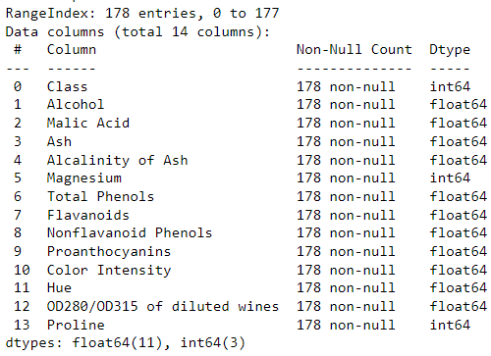
Wine Clustering Analysis
Unsupervised machine learning algorithms learn patterns from data without label
Techniques like clustering group similar data points, while dimensionality reduction simplifies complex data while retaining key details
In this wine clustering analysis, grouping patterns are explored by applying various techniques
The wine dataset comprises 178 data points and encompasses 14 columns.
The datatypes within the dataset include both integers and floating-point values and no missing data
There are 3 classes in this data

Slide 3
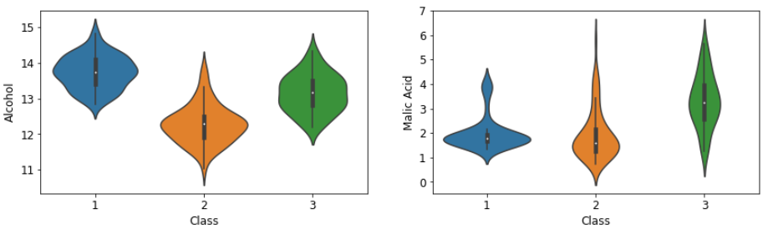
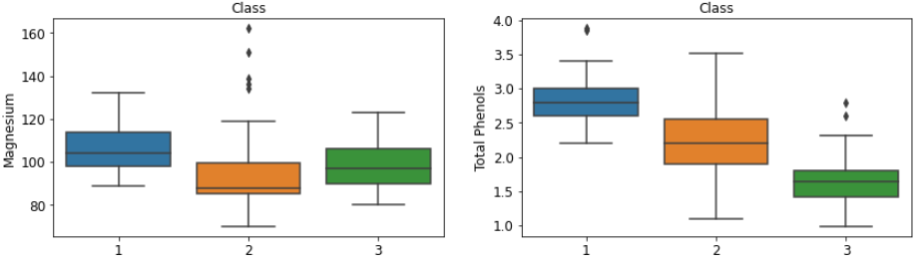
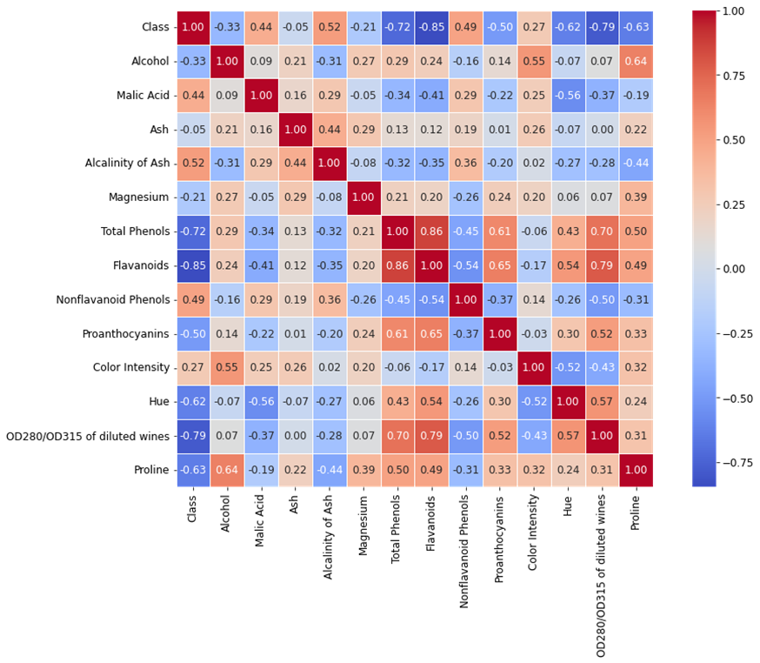
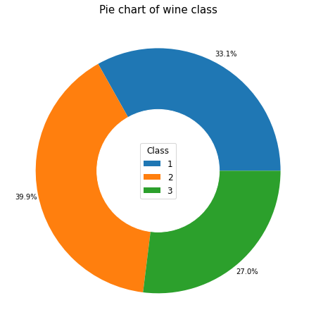
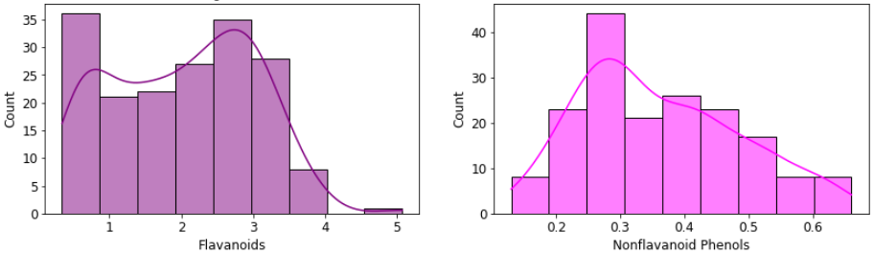
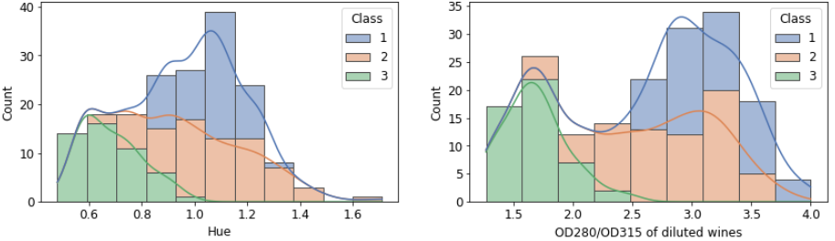
Data visualization
This analysis consists of a range of visualizations aimed at investigating frequencies, correlations, comparisons, and various other insights
The known distribution across wine classes is as follows:
class1 33.1%, class2 39.9% and class 3 with 27% of counts.
This showcases the distinct wine classes distributions in Violin plots, Box plots and Histograms
The strongest correlation observed is between Total Phenols and Flavonoids, with a correlation coefficient of 0.86.

Slide 4
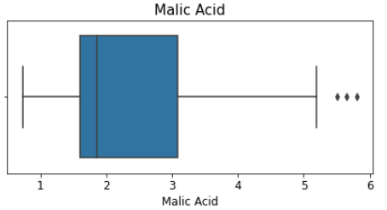
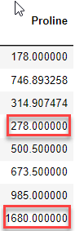
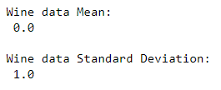
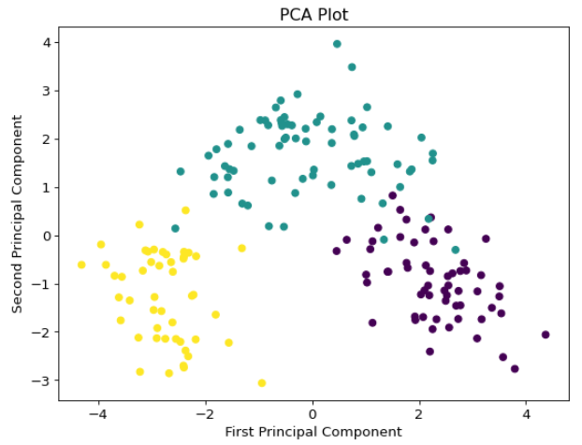
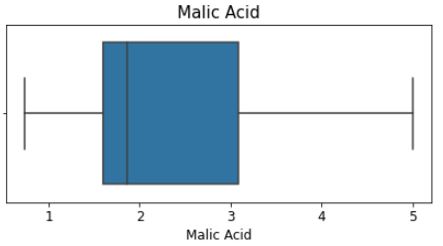
Data pre-processing
Managing Outliers
The outliers are managed by IQR method
Standard Scaling
Standardized features to a mean of 0 and standard deviation of 1
Principal Component Analysis
Applied PCA and capture 56% of variances into 2 components pc1 and pc2
before
after

Slide 5
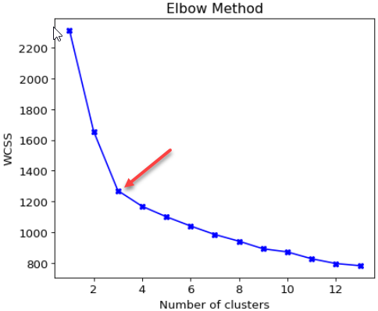
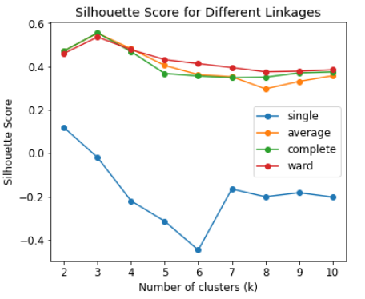
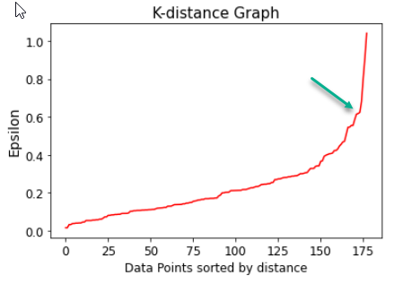
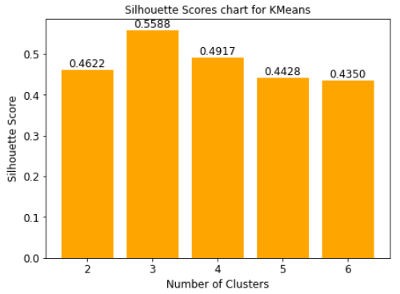
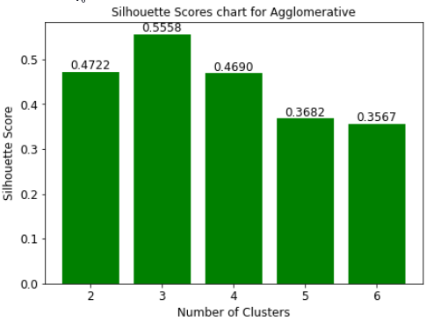
Model building
K-Means
Applied various k-values to identify best groupings of wine data. Elbow and Silhouette score methods applied to find best k
Agglomerative
Applied various linkage methods to identify best grouping of wine data. Silhouette score is used for best n-clusters
DBSCAN
Applied K-Distance graph to identify the best Epsilon value to group the wine data

Slide 6
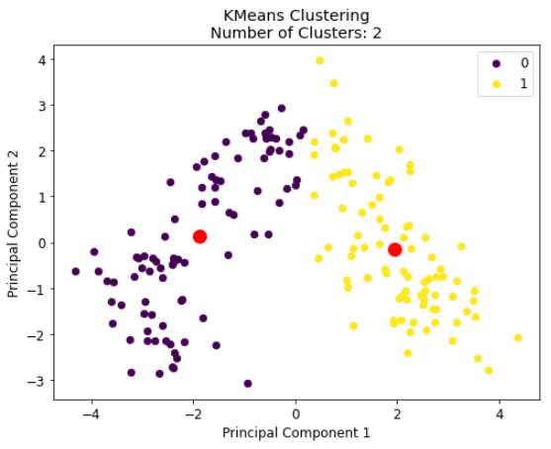
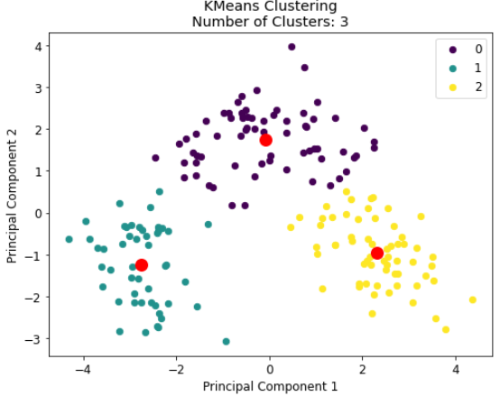
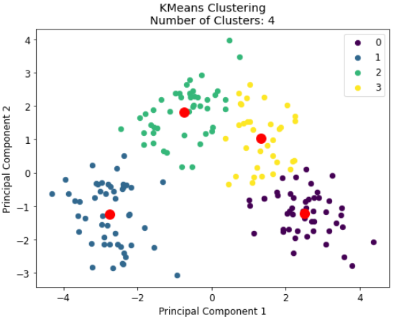
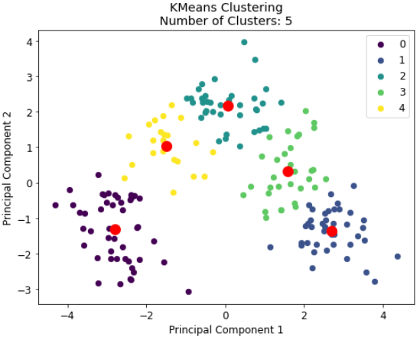
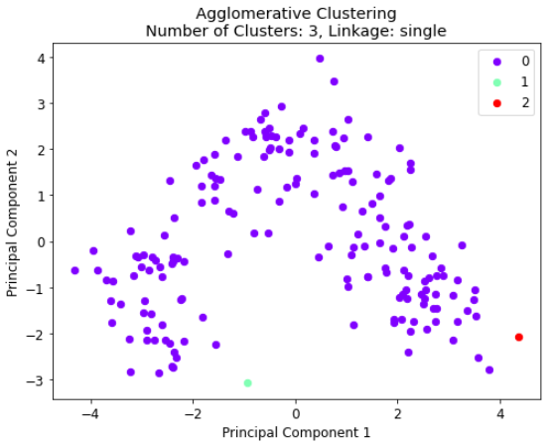
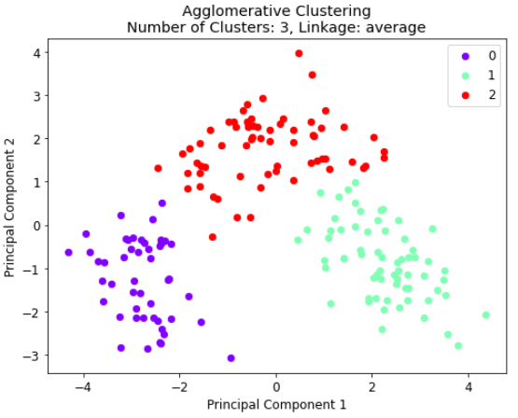
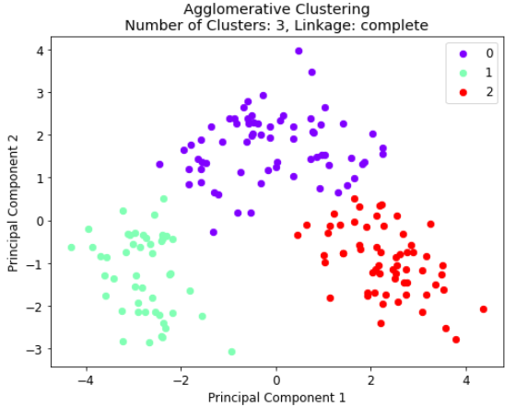
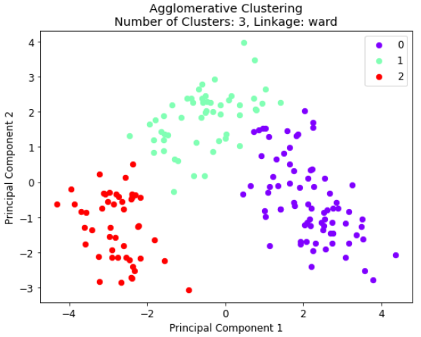
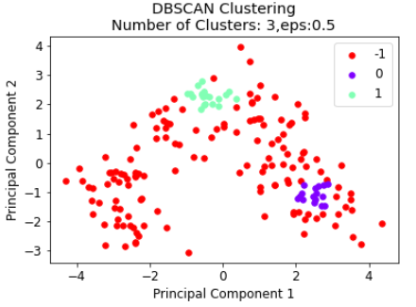
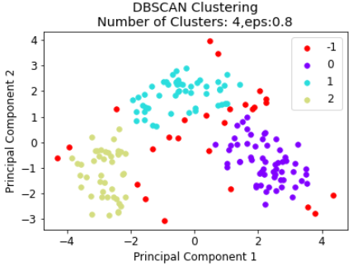
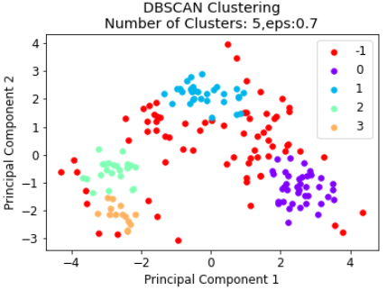
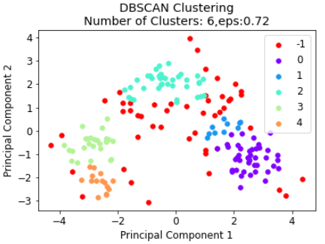
Clustering models
K-Means
Agglomerative
DBSCAN

Slide 7
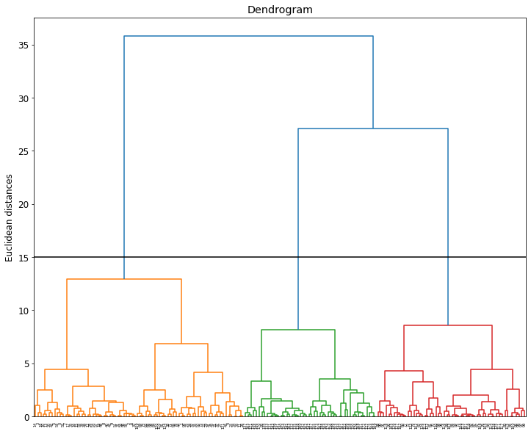
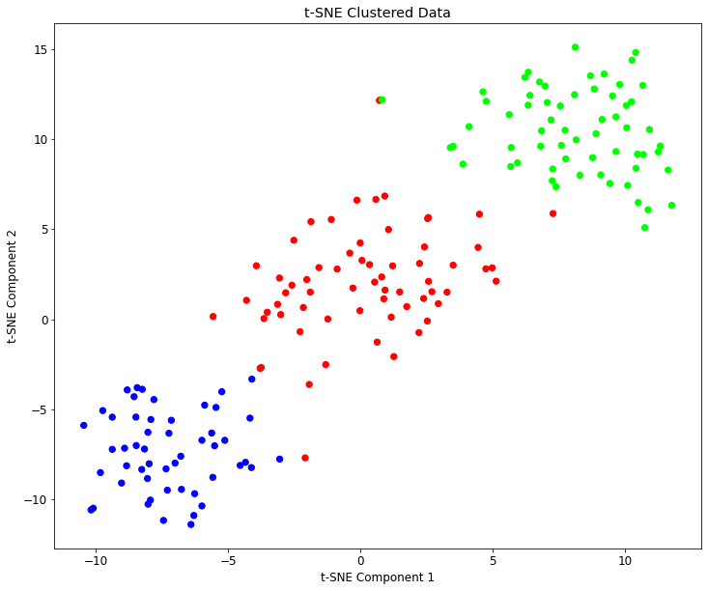
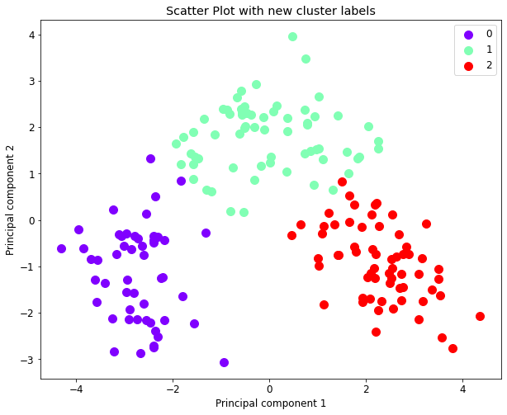
Final Model
Best model: K-Means
The K-Means algorithm demonstrated its effectiveness in distinctly grouping the wine clusters when k=3
This conclusion is drawn form the Elbow and higher Silhouette score of 0.56.
This observation is consistent with the insights gained from both the dendrogram and t-SNE visualizations.

Slide 8
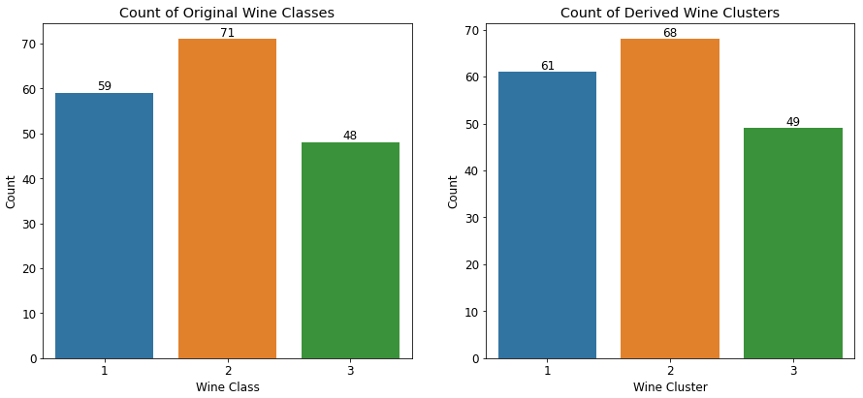
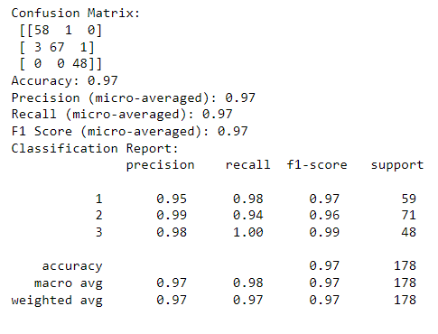
Model evaluation matrix
Accuracy
Confusion Matrix
F-Score
Precision & Recall
In first row, 58 instances of true class 1 are correctly classified under cluster 1, and 1 instance of true class 1 that is incorrectly classified under cluster 2.
The precision of each cluster indicating that it correctly predicts the class with 95%,99% and 98% for cluster1, 2, and 3, respectively.
Class 1: The F1-score is 97%. This indicates a balance between precision 95% and recall 98% for this class.
The clustering accuracy is 97% is the ratio of the number of correct predictions against the number of actual classes
The recall values for each class 98% for class 1, 94% for class 2, and 100% 1.00 for class 3 indicate how well the model is correctly identify instances of each class out of the total instances of that class.
In 2nd row, 67 instances of true class 2 are correctly classified under cluster 2, 3 instances of true class 2 are incorrectly classified under cluster 1, and 1 instance incorrectly classified under cluster 3.
In 3rd row, 48 instances of true class 3 are correctly classified under cluster 3.
Class 3: The F1-score is 99%. With high precision 98% and recall 100% , the F1-score for class 3 indicates that the model is performing well in terms of both false positives and false negatives for this class.
Class 2: The F1-score is 96%. Like class 1, this F1-score suggests a good balance between precision 99% and recall 94% for class 2 predictions.

Slide 9
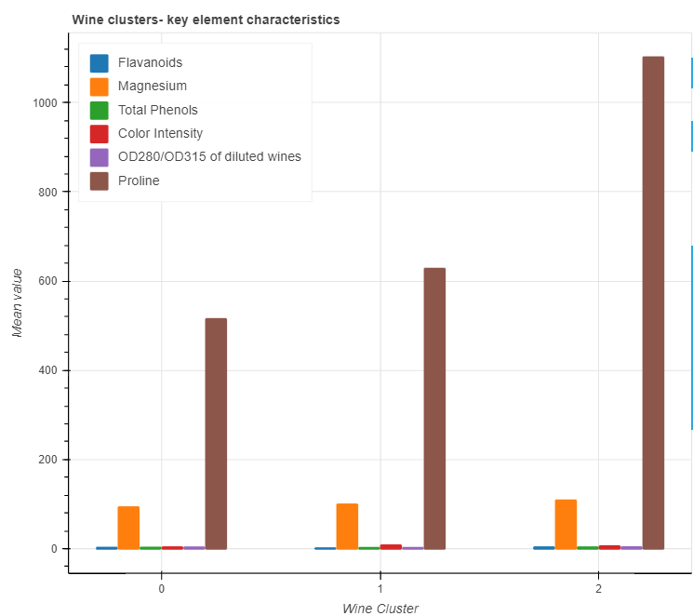
Conclusions
Key wine elements | Cluster- 0 (Class-2) | Cluster -1 (Class-3) | Cluster -2 (Class-1)
Flavonoids | Medium | Low | High
Magnesium | Low | Medium | High
Total Phenols | Medium | Low | High
Colour Intensity | Low | High | Medium
OD280/OD315 | Medium | Low | High
Proline | Low | Medium | High
Wine class 1 exhibits a distinct characteristic, with a notably higher concentration of key elements. The presence of these higher key elements sets this class apart, suggesting a unique composition.
Wine class 2 displays a lower to medium concentration of key elements. This concentration pattern reflects the specific attributes that define class 2's composition.
Wine class 3 occupies an intermediate position in terms of key element concentration. Class 3 maintains a balanced presence of key elements, placing it in the middle ground among the wine classes.
The varying concentrations of key elements across the different wine classes contribute to their distinctive profiles. This differentiation underscores the importance of these key elements in characterizing and categorizing the wines into their respective classes.

Slide 10
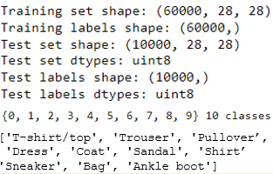
Fashion MNIST Deep Learning Analysis
Deep learning is part of machine learning, involves neural networks with multiple interconnected layers.
Designed to learn and enabling the model to understand complex patterns.
Deep learning can achieve remarkable results in tasks like image recognition, natural language processing, and game playing.
In this analysis, Fashion MNIST image data is explored for predictive insights using unseen test data.
The Fashion MNIST training dataset consists of 60,000 grayscale images, each with dimensions of 28x28 pixels.
The test dataset comprises 10,000 grayscale images, also with dimensions of 28x28 pixels.
This dataset is categorized into 10 distinct classes.

Slide 11
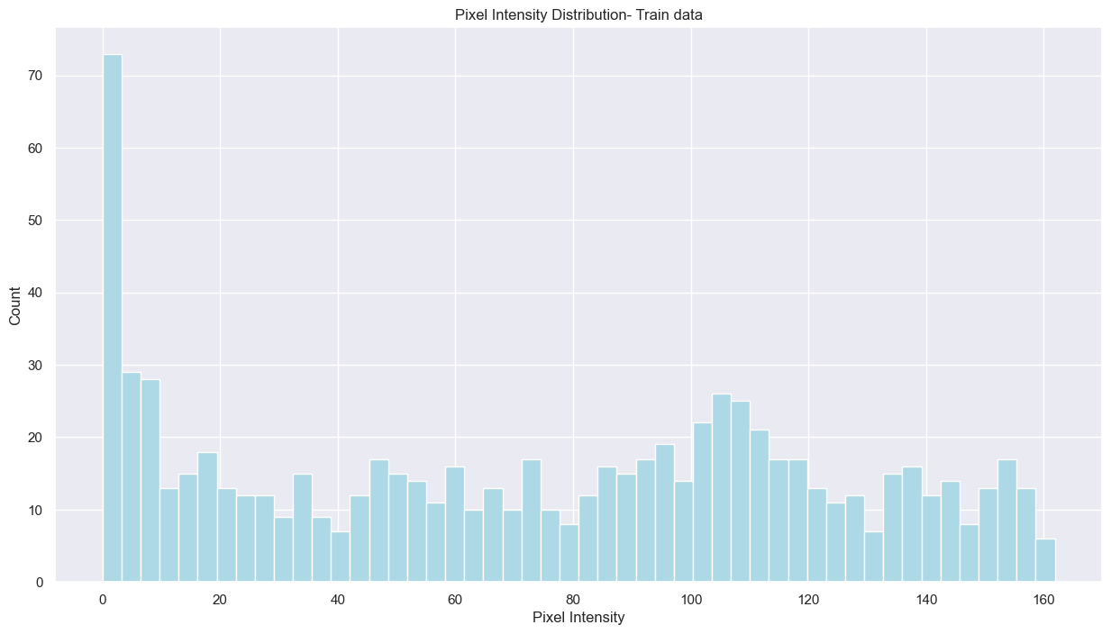
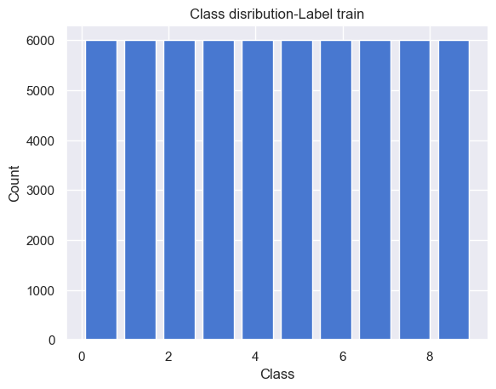
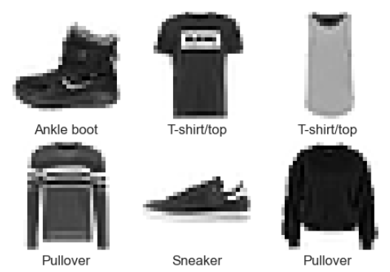
Data visualization
The histogram shows higher peaks are close to zero means that most pixel intensities are concentrated towards lower values.
The lower pixel intensities with zeros corresponds to darker regions, while higher pixel intensities correspond to brighter regions.
The label distributions are equally distributed within 10 classes.
Also, attached image samples in the dataset.

Slide 12
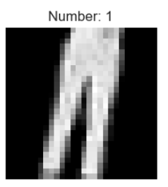
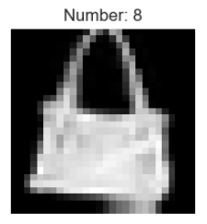
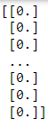
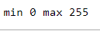
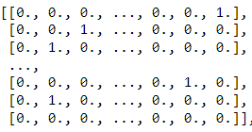
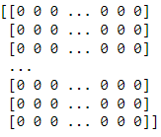
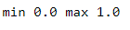
Pre-processing
Reshape
One-hot encoding
Multiclass labels data into one-hot encoded vectors
Augmentation
60,000 grayscale images of size 28x28 pixels reshape to (60000, 28, 28, 1)
This involves applying various transformations to the original images to create new, slightly modified versions of the data
Scaling
Scales the pixel values in the range [0, 255] to the range [0, 1]
Augmented images

Slide 13
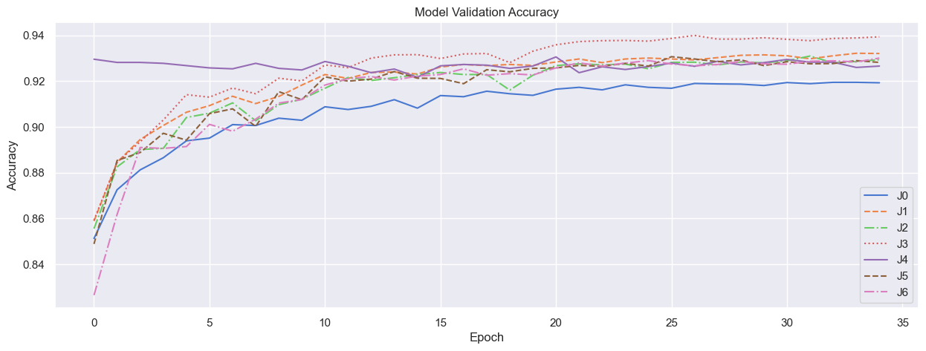
Building CNN Architectures
Pre-trained 7 CNN architectures (ideal for images) for model selection, training and evaluation
The best performance achieved with the combination with batch normalization and dropout is architecture J3
3 - 32 filters with 2-3x3 kernel and a 5x5 kernel with stride 2
3 - 64 filters with 2-3x3 kernel and a 5x5 kernel with stride 2
Fully connected dense layer with 128 neurons
Output connected dense layer with 10 neurons for each class

Slide 14
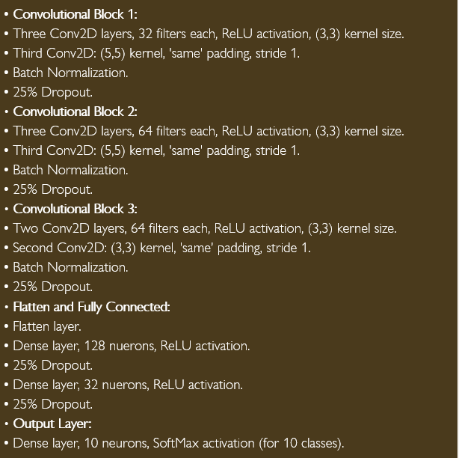
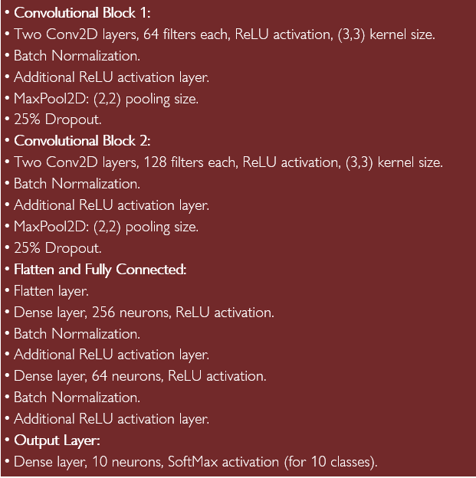
Modified CNN Architecture
CNN Architecture -1
CNN Architecture -2

Slide 15
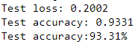








Model training and results comparison
Batch size 16
Batch size 32
Batch size 64
Model 1(Architecture 1)
Applied augmentation
Optimized learning rate
Model 2 (Architecture 1)
No augmentation
Optimized learning rate
Model 3 (Architecture 2)
Applied augmentation
Optimized learning rate

Slide 16






Accuracy and loss comparison of batch size 16
Model 1(Architecture 1)
Batch size 16
Model 2 (Architecture 1)
Batch size 16 no augmentation
Model 3 (Architecture 2)
Batch size 16

Slide 17





Accuracy and loss comparison of batch size 32
Model 1(Architecture 1)
Batch size 32
Model 2 (Architecture 1)
Batch size 32 no augmentation
Model 3 (Architecture 2)
Batch size 32

Slide 18




Accuracy and loss comparison of batch size 64
Model 1(Architecture 1)
Batch size 64
Model 2 (Architecture 1)
Batch size 64 no augmentation
Model 3 (Architecture 2)
Batch size 64

Slide 19


Accuracy and loss comparison of models (combined)
Model 1:
Exhibiting enhanced performance in terms of closely aligned train and test accuracies with 93%. The presence of a moderate level of test loss (0.2007) underscores its superior performance.
Model 2:
Absence of data augmentation yields an inferior model that showcases overfitting, resulting in diminished accuracy and elevated test loss.
Model 3:
Demonstrating performance comparable to Model 1, but with a minor variance (1%) between train and test accuracies of. Remarkably, it achieves the lowest test loss ( 0.1796) among the three models

Slide 20


Model selection and evaluation matrix
Final model: Model1 with 16 batch size
Accuracy
Confusion Matrix
F-Score
Precision & Recall
The confusion matrix involves 10 classes where the diagonal elements from top left to bottom right is show the number of correct predictions for each class.
The precision is 93%, which measures correctly predicted positives relative to total predicted positives.
The F1 score is 93%, which balances precision and recall
The clustering accuracy is 93% is the ratio of the number of correct predictions against the number of actual classes
The recall is 93%, which gauges correctly predicted positives against total actual positives.

Slide 21


Predictions
The model assigns a probability score to each possible class for each image.
For each image, the class with the highest probability score is selected as the predicted class.
If the predicted class matches the actual class of the image, a blue bar will be displayed.
If the predicted class does not match the actual class of the image a red bar will be displayed.
Conclusions
Explored Fashion MNIST data, visualized intensity distributions, scaled and encoded data, used data augmentation.
Tried two CNN architectures with varied batch sizes, optimizing with learning rate reductions.
Model 1 excelled in accuracy, loss, and no overfitting. Its consistent performance, lower test loss, and accurate predictions led to final selection.
Demonstrated effectiveness of CNN architecture in precise classification of Fashion MNIST items.

Slide 22
Thank you
Sunil Kumar

